Slide 1
20XD24 - OBJECT ORIENTED PROGRAMMING
Chapter – 6
Polymorphism

Slide 2
Outline
Basics of polymorphism
Types of polymorphism
Compile and Run Time Polymorphism
Virtual Function
Object Slicing
Virtual Destructor
Dynamic Binding

Slide 3
Basics of Polymorphism
  Greek word meaning - many or multiple forms.
  In programming languages, polymorphism means that some code or operations or objects behave differently in different contexts
  It provides a single interface to entities of different types
  Types of Polymorphism
Polymorphism
Static Polymorphism
Dynamic Polymorphism
Function Overloading
Operator Overloading
Virtual Function

Slide 4
Basics of Polymorphism
Binding
  Determining a location in memory by the compiler
  Connecting a function call to a function body
  The location may represent the following
    Variable names bound to their storage memory address (offset)
    Function names bound to their starting memory address (offset)
Two kinds of binding
  Compile-time Binding (or) Static binding (or) Early binding
  Run-Time Binding (or) Late binding

Slide 5
Static Polymorphism
Compile-time binding or early binding is called as static polymorphism
Compile-Time Binding means
  Compiler has enough information to determine an address (offset)
  Named variables / function calls have their addresses fixed during compilation

Slide 6
Runtime Polymorphism
Dynamically choosing which function to call
It is just a way of choosing which function to execute when there are multiple functions that match a function call
Remarkably, it permits us to delay choosing which function to call until the moment of the call itself

Slide 7
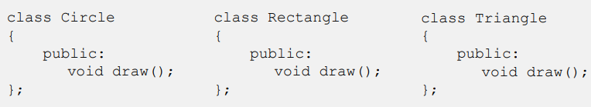
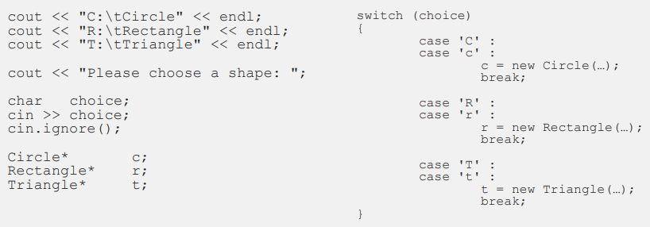
Drawing Shapes Without Polymorphism

Slide 8
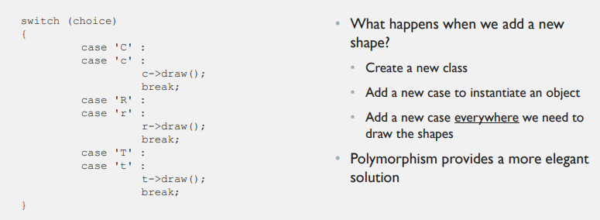
Drawing Shapes

Slide 9
Polymorphism Requirements
  Inheritance
  Upcasting
  A pointer or reference variable (polymorphism cannot operate through an automatic variable)
  Function overriding
  Virtual functions

Slide 10
Casting Objects
Casting is done with an operator:
  (type)exp (C++ syntax) or
  type(exp) (C Syntax)
The cast operator forms an expression
Casting does not change the original value
Example
  double pi = 3.14159;
  int i = (int)pi;
  int i = int(pi);
  The value stored in pi is unchanged
  The value stored in i is 3

Slide 11
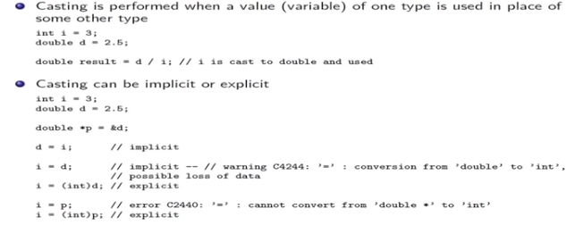
Casting : Basic Rules

Slide 12
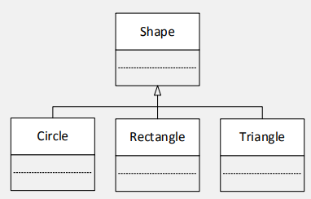
Casting Objects
Casting objects is only possible when the objects are instances of classes related by inheritance
  A Circle “is a” Shape
  A Student “is a” Person
  Makes no sense to cast an Student into a Shape
Upcasting
  Upcasting takes place when a subclass object is converted into a superclass object
  Upcasts are safe and take place automatically without casting notation:
  Circle* c = new Circle;
  Shape* s = c;

Slide 13
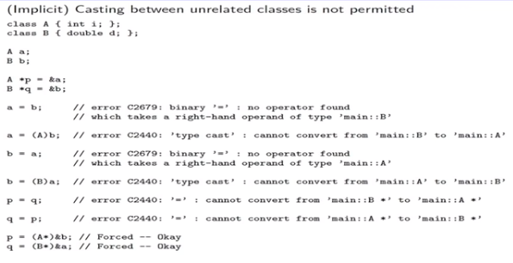
Casting Objects

Slide 14
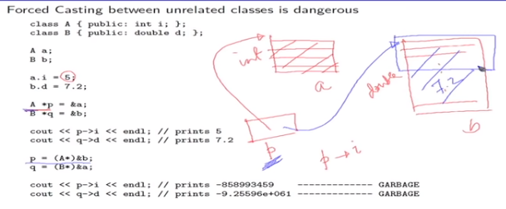
Casting Objects

Slide 15
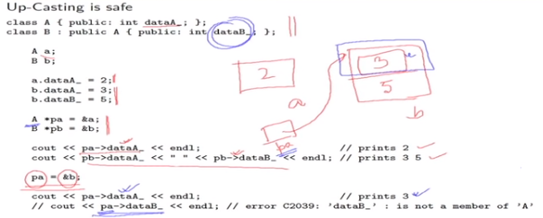
Casting on a Hierarchy

Slide 16
Different ways of Upcasting
Taking the address of an existing object and assigning it to a part pointer
D my_d;
B* a_ptr = &my_d;
Dynamically creating a new object and assigning the address to a parent pointer
B* a_ptr = new D;

Slide 17
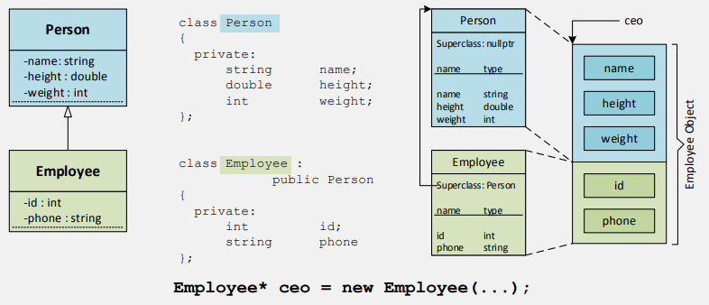
Inheritance and Member Variables

Slide 18
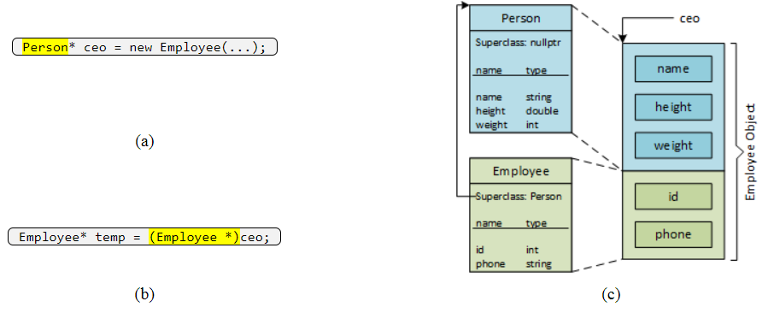
Inheritance and Casting
Upcasting: The Employee object has "id" and "phone" member variables but they are unreachable because "ceo" is a Person pointer.
Downcasting : "ceo" is a Person
Because inheritance is a unidirectional relationship (from subclass to superclass), the compiler is unable to access the Employee symbol table entry, which means that it cannot access "id" or "phone" even though they are part of the original Employee object.

Slide 19
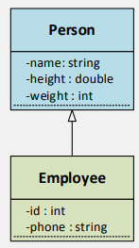
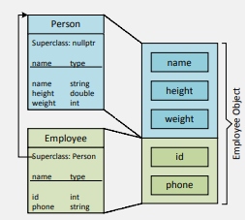
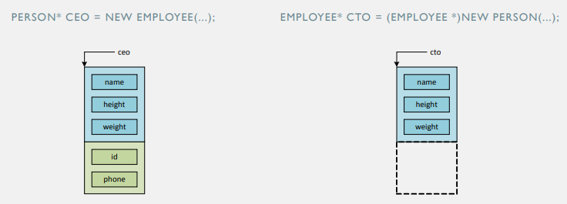
Downcasting vs Upcasting

Slide 20
Downcasting vs Upcasting
Person* ceo = new Employee(...);
The statement instantiates an Employee object (the large rectangle) that has five member variables - three that belong to Person (the blue part) and two that belong to Employee (the green part). The Employee object is upcast to a Person, which makes the id and phone members unreachable. Aside from loosing access to the Employee members, the upcast causes no harm
Employee* cto = (Employee *)new Person(...);
Downcasting can create phantom members. The statement instantiates a Person (parent) object but downcast it to an Employee (child) object. The variable cto is a pointer to an Employee, which allows the compiler to access the Person members, which is completely safe. However, being an Employee pointer also allows the compiler to access the Employee members, which were never created because it was a Person object that was instantiated! Attempting to use the phantom members will produce unpredictable and completely incorrect results

Slide 21
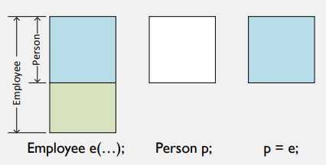
Object Slicing
Polymorphism requires a pointer or reference variable, and so upcasting, also a requirement for polymorphism, is typically done with pointers
What happens if we attempt an upcast with a value variable (i.e., a variable that is neither a pointer nor a reference)?

Slide 22
Slicing
Upcasting without pointers results in slicing
Employee e(...);
Person p;
p = e;
An instance of Employee is created - it consists of a Person sub-object and a part that is unique to Employee
An "empty" Person object is created; this operation allocates only enough memory to hold a Person object
The Employee object is assigned (i.e., copied) to the Person object, but the Person object does not have space (i.e., memory) to hold the complete Employee object, and so the part of the Employee object that lies beyond the Person subobject is sliced off

Slide 23
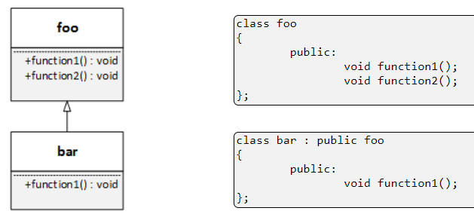
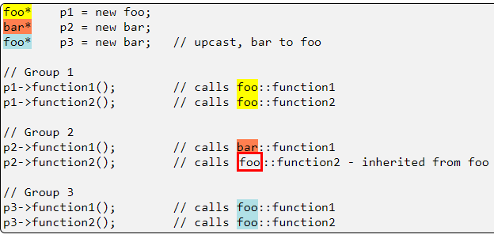
Casting And Member Functions

Slide 24
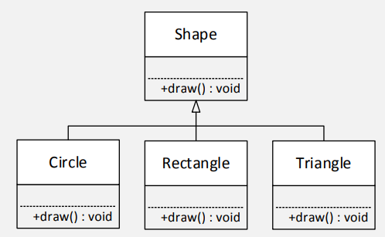
Function Overriding
Overloaded Functions
  Are defined in the same class
  Must have unique argument lists
  May have different return types
Overridden Functions
  Are defined in two classes that are related by inheritance
  Must have the same name
  Must have exactly the same argument list
  Must have the same return type

Slide 25
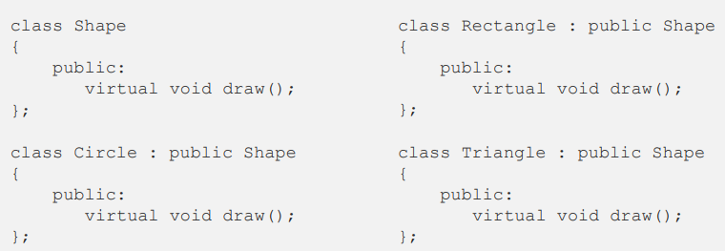
“virtual” enables Polymorphism
UPCASTING WITH POINTERS
Shape* s = new Circle(...); // Upcasting
s->draw(); // invokes draw() in Circle class

Slide 26
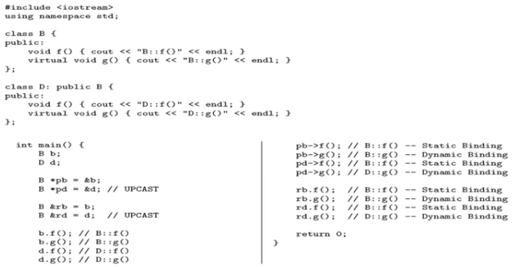
Static and Dynamic Binding

Slide 27
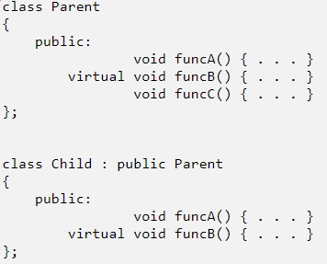
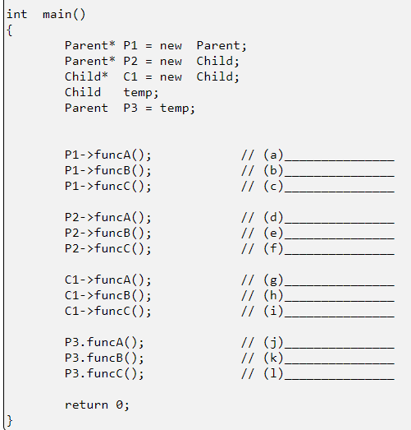
Quiz

Slide 28
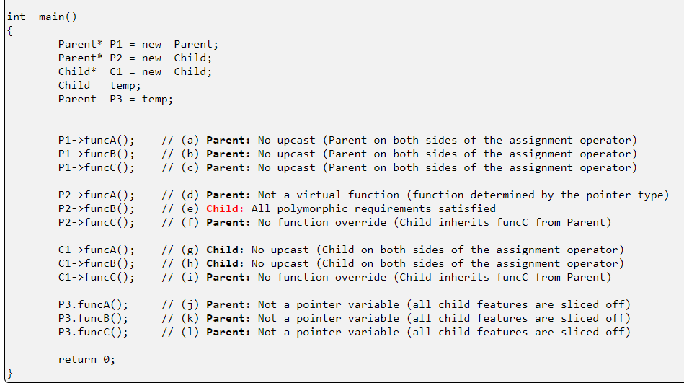
Solution

Slide 29
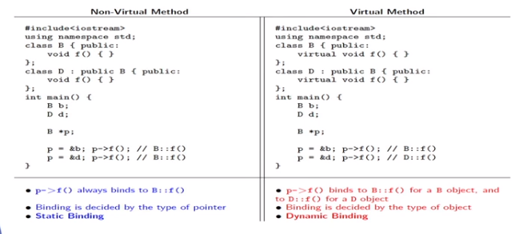
Dynamic Binding

Slide 30
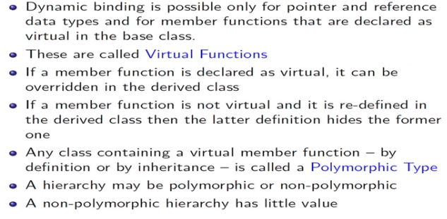
Polymorphic Type : Virtual Functions

Slide 31
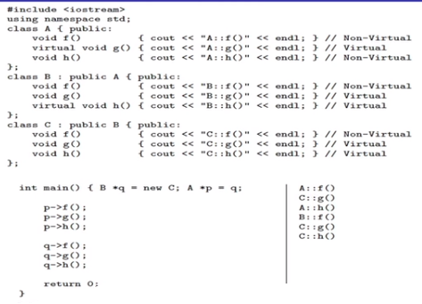
Polymorphic Rule

Slide 32
Virtual Function Implementation
VTABLE (Virtual Table)
The compiler creates a VTABLE for every class and its derived class having virtual functions, which contains addresses of virtual functions
If no function is redefined in the derived class that is defined as virtual in the base class, the compiler takes the address of base class function.
VPTR ( Virtual Pointer)
When objects of base or derived classes are created, a void pointer is inserted in the VTable called VPTR

Slide 33
Virtual Function Implementation
class Base
{
public :
Base() { }
virtual void f1() { cout<<”base::f1( )” << endl; }
virtual void f2( ) { cout << Base:: f2()”<<endl; }
void f3() { cout<<”Base :: f3()”<<endl; }
};
class Derived :public Base
{
public:
Derived() { }
void f1() { cout<<”Derived ::f1()”<<endl; }
};
void main()
{
Base b1;
Derived d1;
Base *p=&b1;
p->f1(); // base::f1
p->f2(); //base::f2
p->f3(); //base::f3
Base *q =&d1;
q->f1(); //Derived::f1
q->f2(); //Base::f2
q->f3(); //Base::f3
}

Slide 34
Virtual Function Implementation
Pointers
Objects
Vtables
Object
b1
Vptr
Base::f1()
P
Base::f2()
Object
d1
Vptr
Derived::f1()
q
Base::f2()

Slide 35
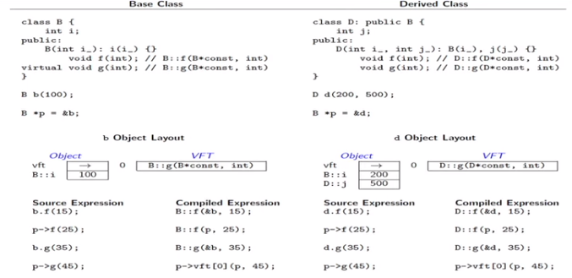
Virtual Function Pointer Table

Slide 36
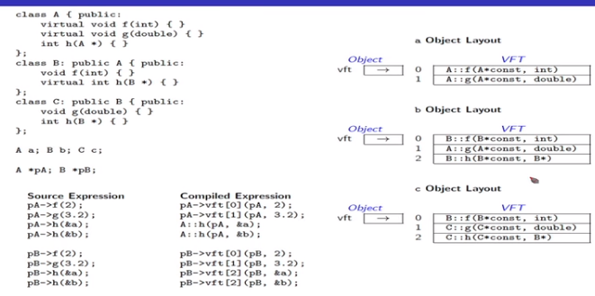
Virtual Function Pointer Table

Slide 37
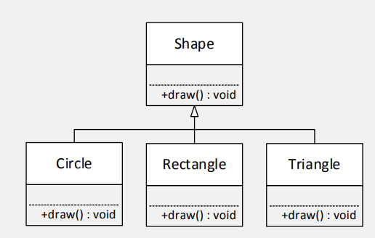
Pure Virtual Functions and Abstract Classes
If we wanted to write the instructions for the Shape class draw function, what would the code look like?
Or put another way, what does a shape look like? A shape, of course, is too general or ambiguous - there are many kinds of shapes. In object-oriented terms, a Shape is too abstract to draw, whereas a Circle, a Rectangle, or a Triangle are sufficiently concrete to draw

Slide 38
Pure Virtual Functions and Abstract Classes
Abstract Class
  A class that serves only as a base class from which other classes can be derived
  If a base class contains pure virtual functions , no instance of the base class can be created
Pure Virtual Functions
  In practical applications, the member functions of base classes is rarely used for doing any operation (null body).
    Syntax: virtual void draw( )=0;

Slide 39
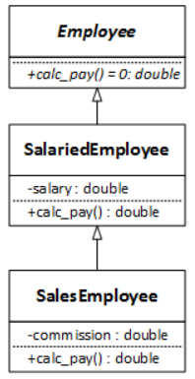
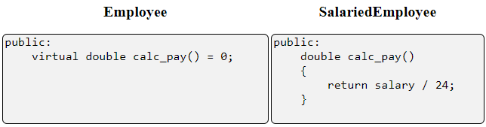
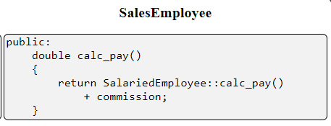
Pure Virtual Functions and Abstract Classes
Employee has an abstract function and so is an abstract class
The salaried and the sales employee classes override the abstract function with concrete functions as so become concrete classes
Abstract classes and functions are denoted in the UML by writing their names in italic characters

Slide 40
Abstract Classes
Classes that have one or more pure virtual functions are said to be abstract
Up to this point, all the classes that we have create or used have been concrete
The difference between concrete and abstract classes is that you may make an instance of a concrete class but you may not make an instance of an abstract class
An abstract class can
  be a base (parent or super) class
  have concrete features (both variables and functions) that can be inherited by derived (child or sub) classes
  participate in (i.e., be the target of) an upcast
  participate in polymorphism

Slide 41
Abstract Classes
class Base
{ public:
virtual void show()=0;
// Pure Virtual function
};
class Derv1 : public Base
{
public:
void show()
{ cout<<” In Derv 1”; }
};
class Derv2 : public Base
{ public:
void show()
{ cout<<”In Derv2”; }
};
main()
{
Base *List[2];
Derv1 dv1;
Derv2 dv2;
List[0]=&dv1;
List[1]=&dv2;
List[0]->show();
List[1]->show();
}

Slide 42
Virtual Destructors
Deleting a derived class object using a pointer of base class type that has a non-virtual destructor results in undefined behavior. To correct this situation, the base class should be defined with a virtual destructor. For example, following program results in undefined behavior
class derived: public base {
public:
derived()
{ cout<<"Constructing derived \n"; }
~derived()
{ cout<<"Destructing derived \n"; }
};
int main(void)
{
derived *d = new derived();
base *b = d;
delete b;
}
#include<iostream>
using namespace std;
class base {
public:
base()
{ cout<<"Constructing base \n"; }
~base()
{ cout<<"Destructing base \n"; }
};
Output : Constructing base
Constructing derived
Destructing base

Slide 43
Virtual Destructors
class derived: public base {
public:
derived()
{ cout<<"Constructing derived \n"; }
~derived()
{ cout<<"Destructing derived \n"; }
};
int main(void)
{
derived *d = new derived();
base *b = d;
delete b;
}
#include<iostream>
using namespace std;
class base {
public:
base()
{ cout<<"Constructing base \n"; }
virtual ~base()
{ cout<<"Destructing base \n"; }
};
Output : Constructing base
Constructing derived
Destructing derived
Destructing base

